Slide 1
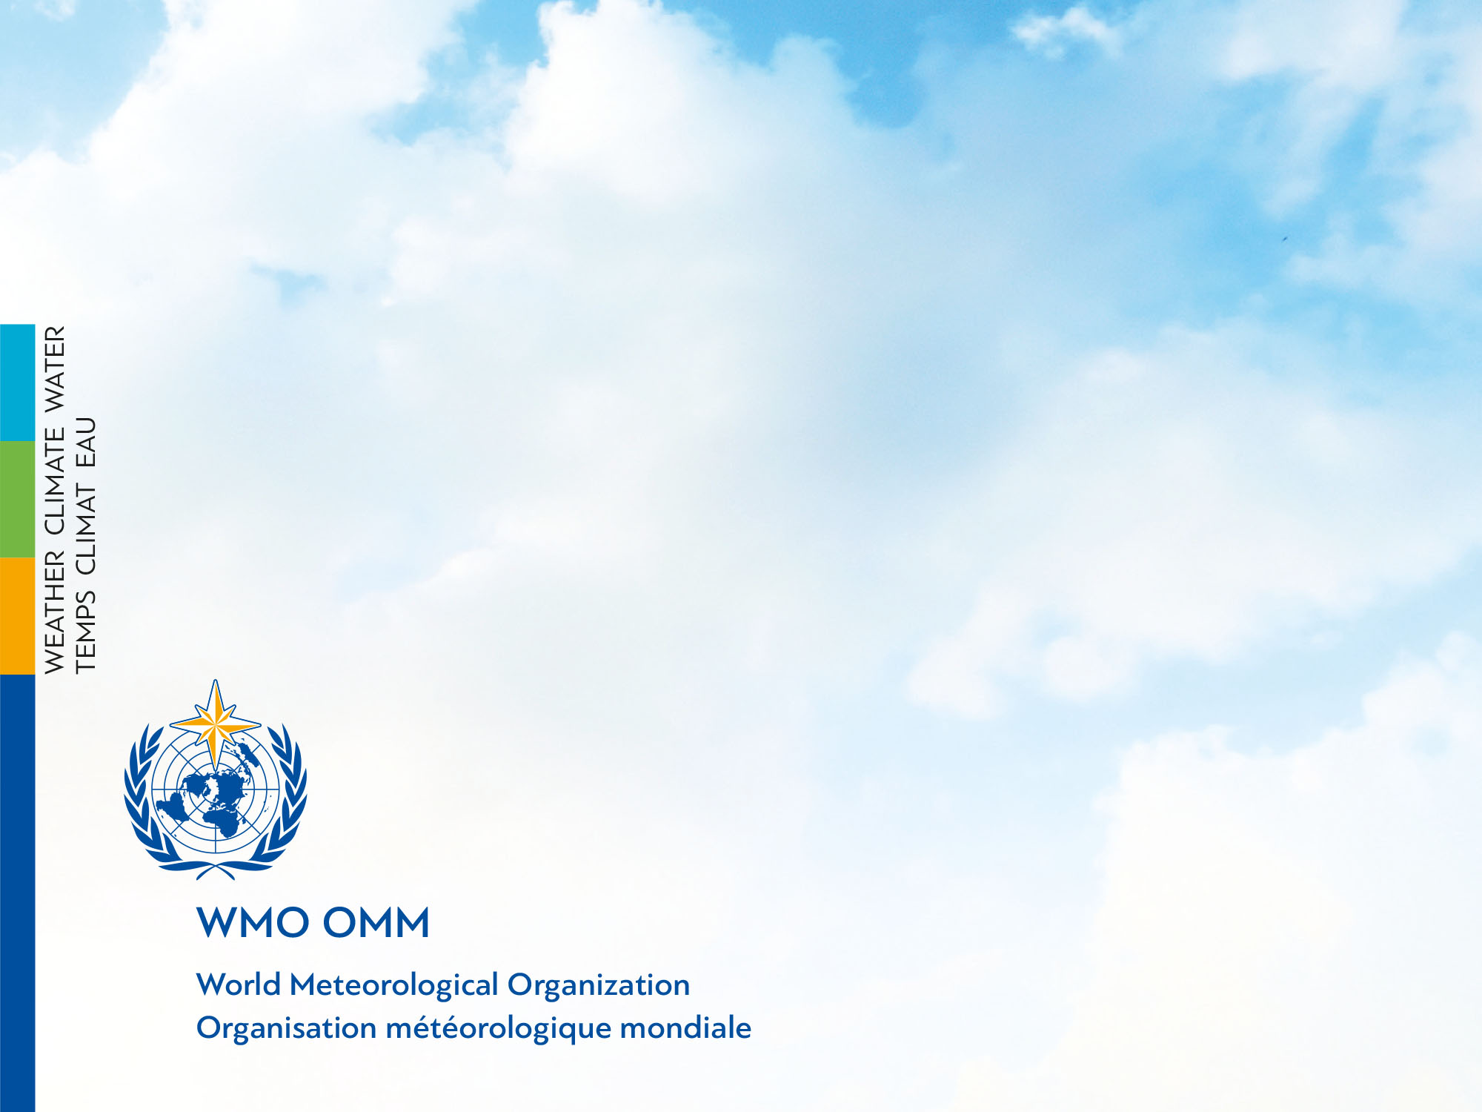

World Meteorological Congress Updates from the WMO/GAW Programme
Stoyka Netcheva
WMO Research Department

Slide 2

The eighteenth WMO Congress
Goal 1: Better serve societal needs: delivering, authoritative, accessible, user-oriented and fit-for-purpose information and services
Goal 2: Enhance Earth system observations and predictions: Strengthening the technical foundation for the future
Goal 3: Advance targeted research: Leveraging leadership in science to improve understanding of the Earth system for enhanced services
Goal 4: Close the capacity gap on weather, climate, hydrological and related environmental services: Enhancing service delivery capacity of developing countries to ensure availability of essential information and services needed by governments, economic sectors and citizens
Goal 5: Strategic realignment of WMO structure and programmes for effective policy- and decision-making and implementation.

Slide 3
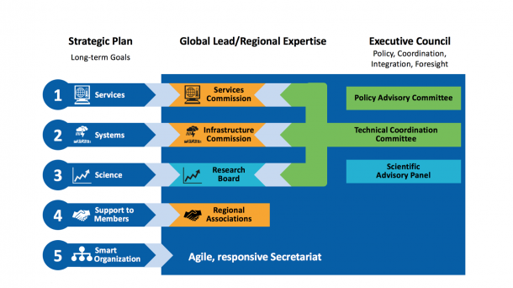
Structure of WMO constituent bodies

Slide 4
Research Board
Advance knowledge of the Earth System (fundamental knowledge development)
Advance policy relevant science (where some interaction with TCs happens)
Enhance connections between the science and the services through the value chain approach (where most of the interaction with other TCs will happen)

Slide 5
GAW Program Elements: Aligning with new WMO structure
Research Infrastructure
Services
IG3IS
AQ forecast
MMF
Urban-Env
SDS
Reports:
GHG
O3
Observations
Stations
Networks
NRT data exchange
QA/QC
Calibration
Data management
Research
New instruments/techniques
Observing systems evolution
Improved models
Data assimilation
Downscaling
Improved parameterizations
Emission inversion
Trends detection
Project Science Teams fostering “translation of science into services”
New Expert Groups on the network management and Quality Assurance
Scientific Advisory Groups more focusing on the scientific aspects

Slide 6
Observing System Capability Analysis and Review Tool (OSCAR)/Surface
Updated OSCAR/Requirements for 14 appl. areas;
On going work toward completing requirements tables;
OSCAR/Space 2.0 deployed and used by the space agencies and the user community;
Under development strategy for the longer-term, IT infrastructure and content;
Operationally deployed in 2016 and offers much more extensive metadata information for far more stations.

Slide 7
Rec. 11 (EC-70) and Res. 41 (Cg-18): Use of OSCAR tool/Surface for the collection and recording of the WIGOS metadata
Submit the required WIGOS metadata to OSCAR for all observing stations (API or manual; for GAW stations through GAWSIS);
Develop and implement procedures for use of machine-to-machine interfaces with OSCAR by Members databases of WIGOS metadata;
Develop WMO stand-alone national implementation metadata management tool for holding national WIGOS metadata;
Nominate OSCAR/Surface National Focal Points to ensure that WIGOS metadata in OSCAR/Surface are maintained to the agreed standard;

Slide 8
GAW Objectives & Implementation
Meeting the growing need for atmospheric composition information and related services requires:
Increased efforts towards enhancing observing systems with broader use of GAW observations and research activities to support the development of services with high societal impact;
Enhanced modeling efforts;
Improved information management infrastructure;
Stronger efforts towards building collaborations, capacity and communications.
Promote a “research value chain” from observations to services

Slide 9
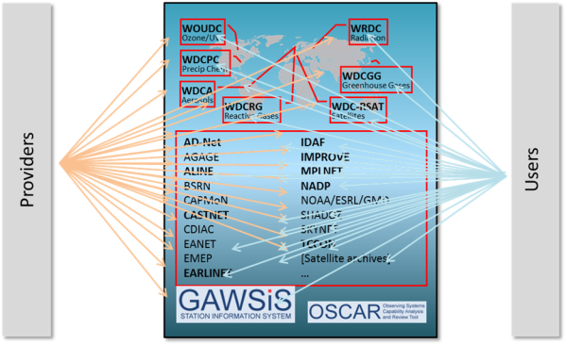
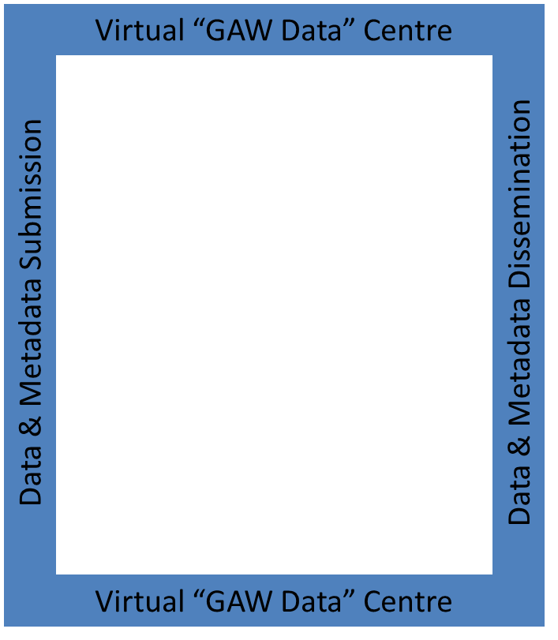
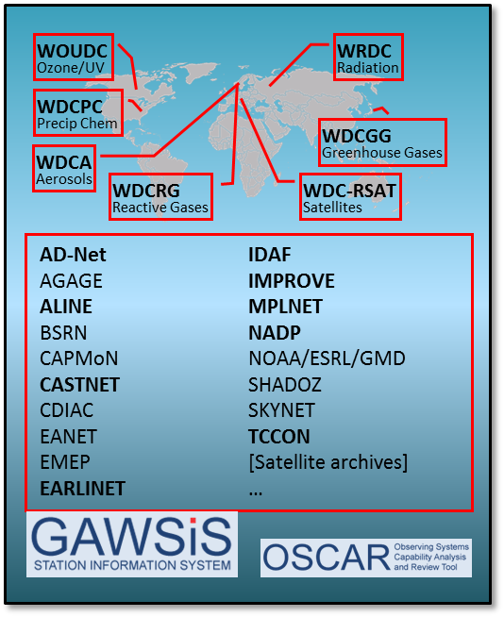
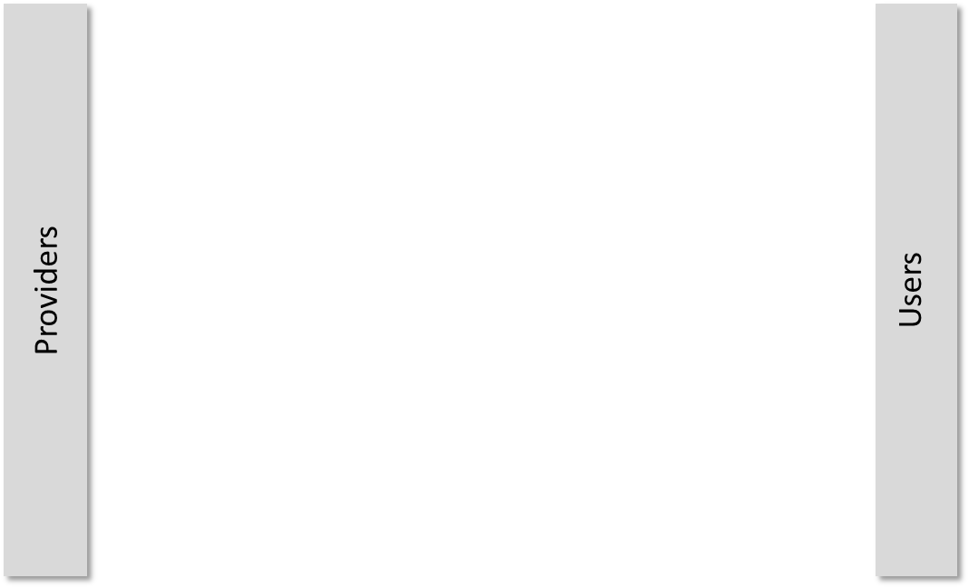

GAW Data Management
Enhancing data
management architectures to
facilitate improved metadata
exchange and interoperability,
data discoverability and analysis,
and to promote and facilitate
The near-real time delivery of data

Slide 10
GAW stations
Global
Regional
Data
GAW Data Centers
World Ozone and Ultraviolet Radiation Data Centre
(WOUDC)
World Radiation Data Centre
(WRDC)
Networks formally
contributing to GAW
(Letter of Agreement)
TCCON
EARLINET
IMPROVE
AD-Net
ALINE
NADP
IDAF (IGAC/DEBITS AFRICA)
MPLNET
GAW
Quality Assurance
Data
World Data Centre for Greenhouse Gases (WDCGG)
World Data Centre for Aerosols (WDCA)
Metadata
World Data Centre for Precipitation chemistry (WDCPC)
World Data Center for Remote Sensing of the Atmosphere
(WDC-RSAT)
Metadata
Metadata
Metadata
Networks, Data Centers,
etc., sharing data with GAW
GAW Station Information System
(Metadata based search interface)
Notes:
GAW data flow

Slide 11
Key priorities
Establish interoperability between data centres and GAWSIS (WDCs, contributing data centres)
Metadata
Data
Expand the federated system to address needs of user communities for improved support of applications/services

Slide 12
Actions in GAW IP: Data Management
Actions in the GAW Implementation Plan | Specific activities, contributors, timelines?
A-DM-1. Establish and implement a federated data management infrastructure including GAW Data Centres, data centres of contributing networks, and GAWSIS that enables interoperable data discovery and access mechanisms. | Next ET-WDC physical meeting to derive work plan (late summer mtg., Q1/2018).
A-DM-2. Improve open access to data and comprehensive metadata including calibration histories of ground-based, aircraft and satellite observations for the primary GAW variables. | Review/confirm data policy. Private sector requirements may be at variance with fair-use policy. Calibration history is embedded in WIGOS metadata standard. Document calibrations (data providers, TT-WMD)
A-DM-3. Harmonize GAW data management activities with the WIGOS framework, in particular with regards to metadata documentation. | WMDS provide framework is implemented in GAWSIS. Interaction between data providers and archives needed (see also A-DM-1 activities).
A-DM-4. Develop and promote support of data archiving and analysis centres that address the needs of applications and service delivery. | Strengthen and expand capacity of existing infrastructures to address these needs. Users and archives need to interact to formulate requirements and specifications. Facilitate remote sessions annually between data archives and user communities (stakeholders) for improved interaction.

Slide 13
Actions in GAW IP: Data Management (cont’d)
Actions in the GAW Implementation Plan | Specific activities, contributors, timelines?
A-DM-5. Ensure that data collected and archived by WMO/GAW WDCs and archives of contributing networks are of known quality, adequate for their intended use and documented comprehensively. | Work with WIGOS metadata standard documentation. Establish plausibility checks at data centres. Services like CAMS should feedback to the observation providers. Establish methodology for users to feedback to providers or quality issues. Archives make provision to accept quality flags.
A-DM-6. Promote delivery of those variables pertinent to air quality and forecasting in NRT, using WMO GTS/WIS as it evolves into an open, decentralized and node-oriented structure. Continue to seize opportunities to expand the NRT delivery services for GAW variables. | In Europe, CAMS is supporting and promoting NRT services. CAMS is engaging in contracts with ICOS, ACTRIS, GAW, and EMEP. Satellite NRT delivery via direct broadcast could be expanded.
A-DM-7. Develop data submission and data use procedures with the inclusion of uncertainties with the GAW data products, making it possible to select and use data in accordance to the criteria set out by the RRR process. | Implement at GAW data centres where not yet employed. The WIGOS metadata standard supports this activity. (as soon as possible)
A-DM-8. Continue to make best efforts towards program-wide adoption of digital object identifiers (doi) for GAW datasets to facilitate proper recognition of the data contributors in scientific analyses and reports and it will also allow for better monitoring of the actual data use. | DOIs are finding acceptance in the community.

Slide 14



Thank you!
Merci!

